Slide 1



Slide 2
PRESENTATION ON salat app
PRESENTED BY
Mohammad Ashraful Islam ; ID: 15162103013 ; SEC: 01 ; INTAKE: 32ND
Sakhawat Ullah ; ID: 15162103015 ; SEC: 01 ; INTAKE: 32ND
Mohammad Saidi ; ID: 15161103034 ; SEC: 01 ; INTAKE: 31ST
Supervised by: Md. Sahiduzzaman (Assistant Professor)
DEPARTMENT OF B.Sc. in CSE

Slide 3
Discussion topic
Why we have chosen this application
Features
Functionalities
Hardware & software requirements
Design
Future Enhancement

Slide 4
Why we have chosen this Application
Every Muslim should know the details of five pillars of Islam.
People should learn Al-Quran and know the details of Hadith
People should know how to perform prayers in Islam
Through this Application, Muslim people can know about Islam

Slide 5
Features
Muslim people can know about the five pillars of Islam
People can learn about Faraj,Sunnah, Wajib and Nafal prayer
People can learn and know about different types of Hadith according to category
People can read Al-Quran and hear the recitation of Al-Quran
People can see the Bangla translation of Al-Quran

Slide 6
Functionalities
One option to learn about Salah Study.
Another option to learn about Hadith.
User can select topic and get details information about that topic.
User can search the desire topic from list
User can select & copy text

Slide 7
Hardware & software requirements
Hardware Requirements:
Processor : Intel® Core™ i3 8th Generation or more
RAM : 8 GB
SSD : 128 GB

Slide 8
Software Requirements:
Build Software : Android Studio
Language : JAVA
Operation System : Windows 10
Database : Static

Slide 9
Design

Slide 10
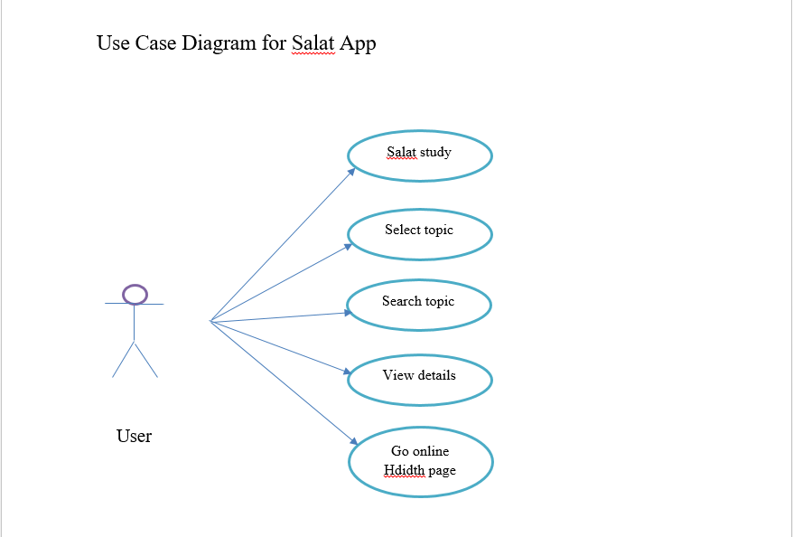

Slide 11
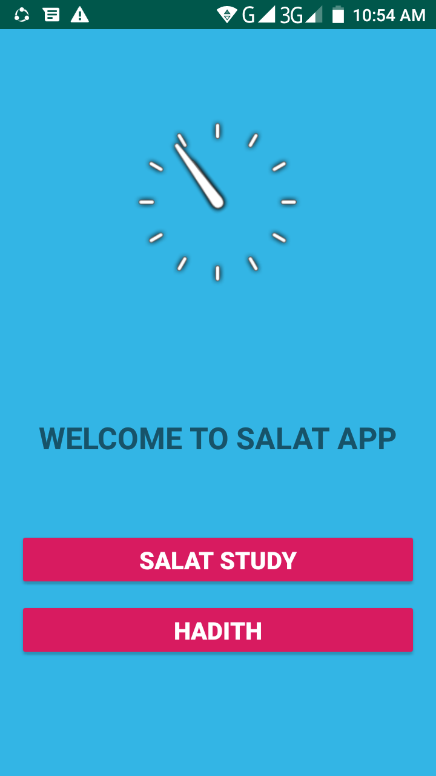
First look of our Application

Slide 12
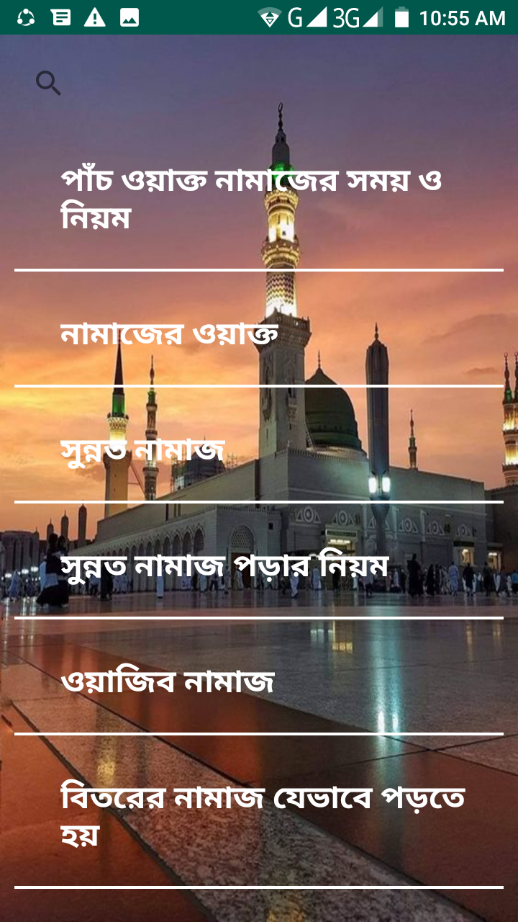
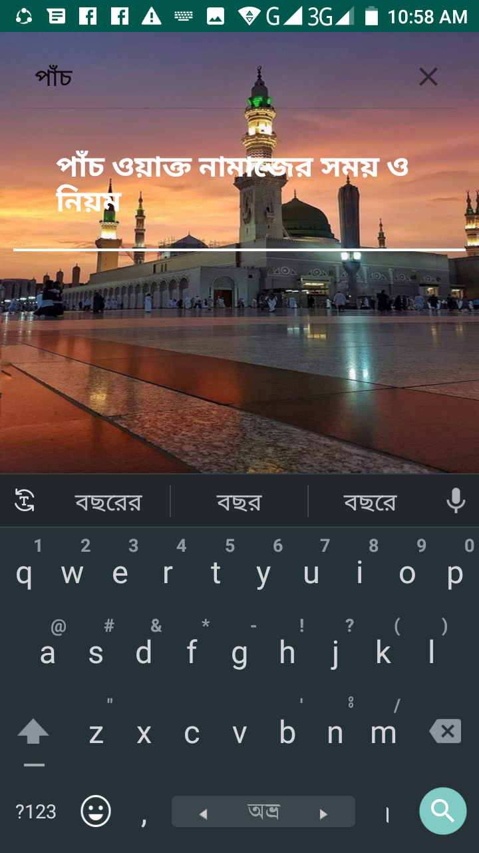
List View page & Searching

Slide 13
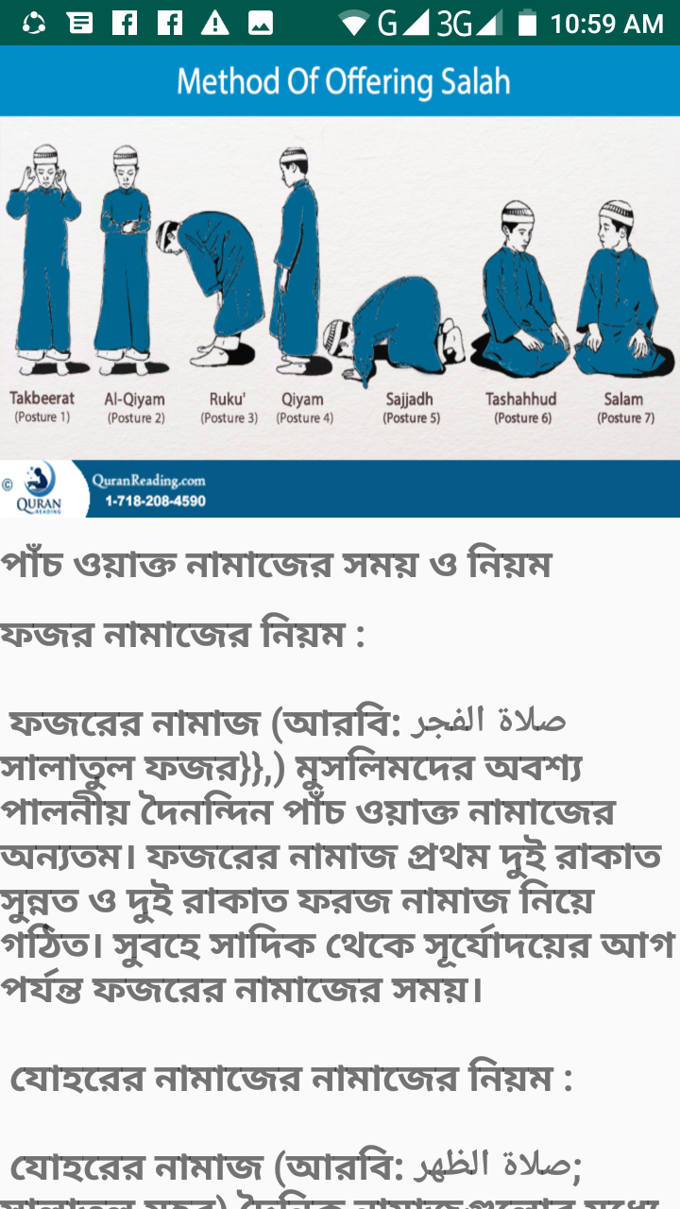
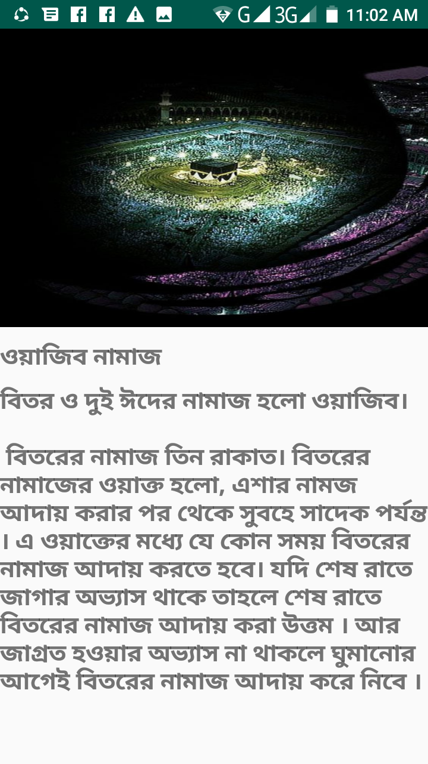
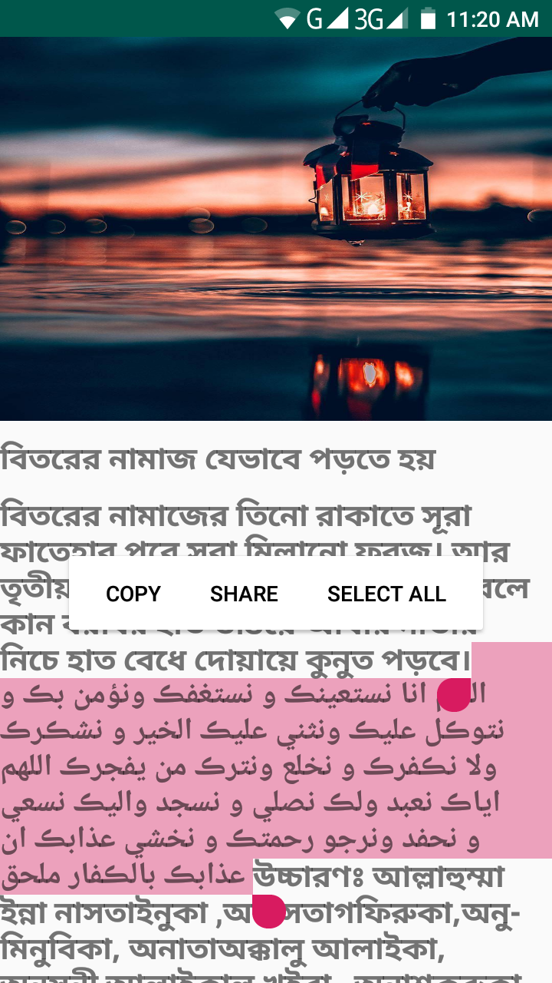
View details of selected topic

Slide 14
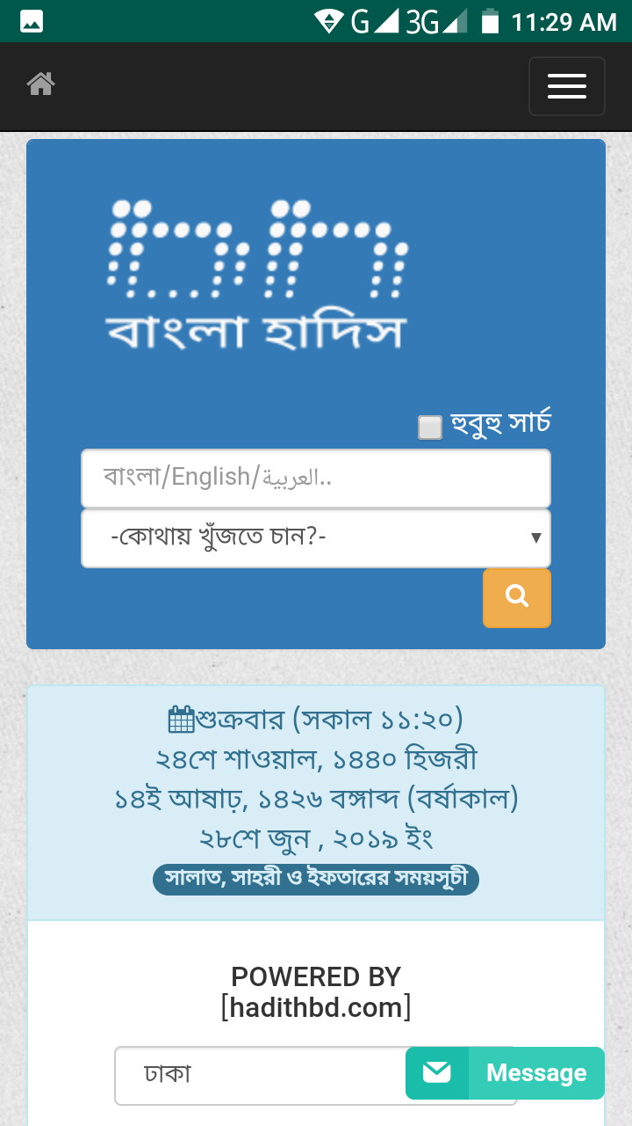
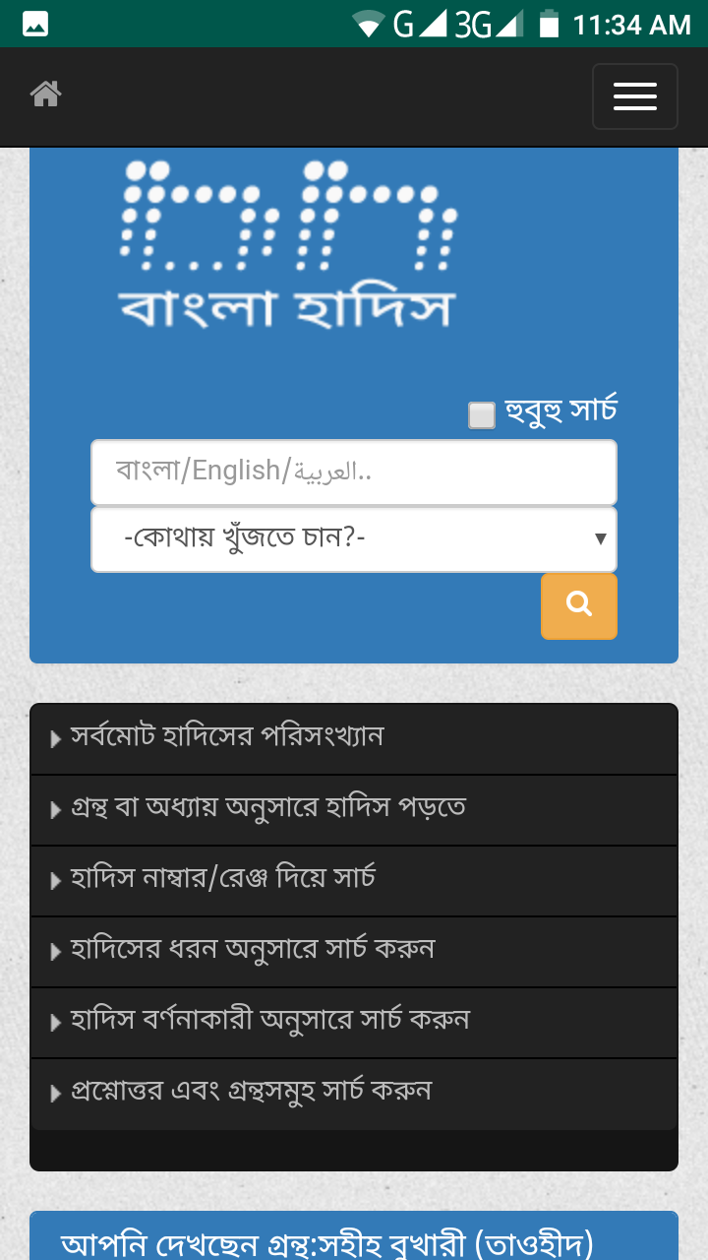
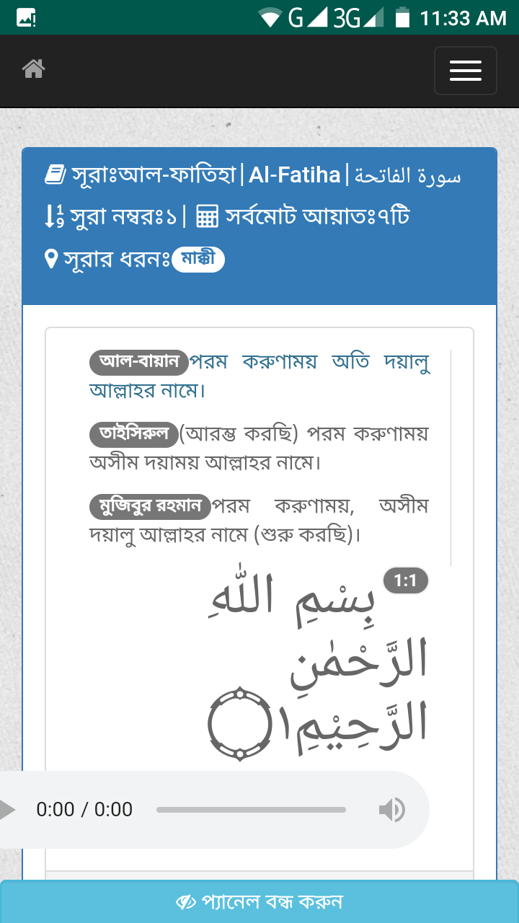
View details about hadith

Slide 15
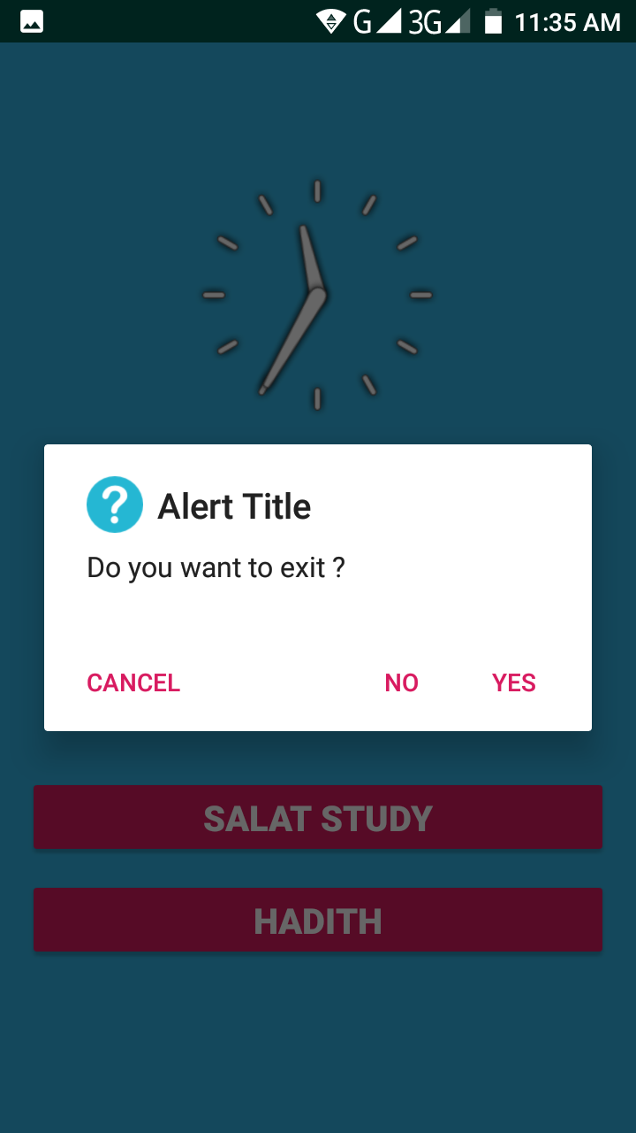
Permission to exit

Slide 16
Future Enhancement
Future Enhancement:
Adding alarm time notification system of Salah
Adding videos of how to pray Salah
Notifications of important Islamic Date.

Slide 17
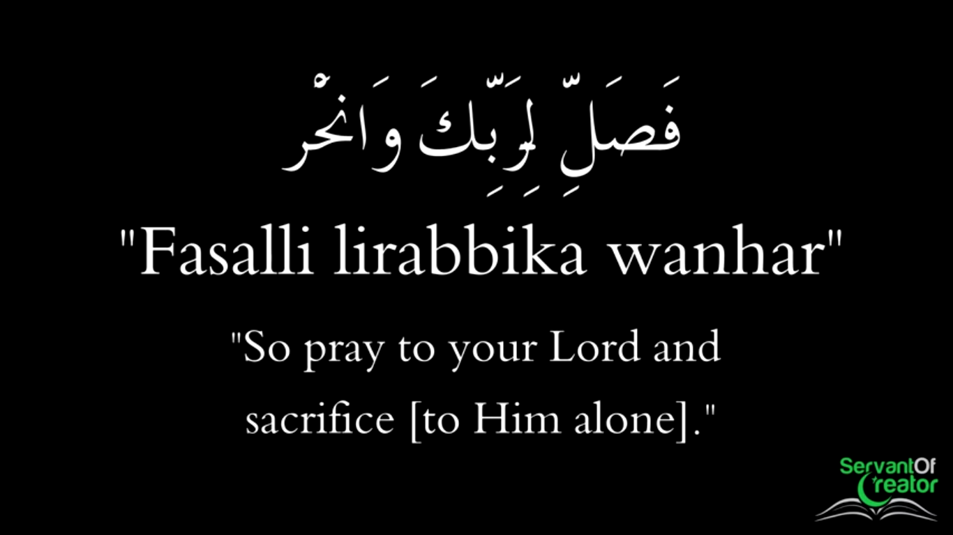
AL Quran-108:2
Thank you For Watching

